Slide 1
Demography - I
Maj Syed Fawad Mashhadi

Slide 2
Definition
Greek word
  Demos
  Graphy

Slide 3
Definition…
Demography is the scientific study of human populations, primarily with respect to their
size,
Structure &
Changes therein

Slide 4
Population size effected by
  Fertility
  Mortality
  Migration

Slide 5
Demography and its linkages with other disciplines
LITERACY
INFLATION
Income
Unemployment
DEMOGRAPHY
Energy
Hunger & poverty
Environment &
sustainability
Individual
freedom

Slide 6
Sources of Population Data
Population censuses
  Defacto
  Dejure
Demographic sample surveys
Registration system and administrative statistics including:
    Vital registration (birth, deaths and marriage)
    Population registers
    Service statistics (from health and family planning programs)
    International migration statistics
Qualitative data

Slide 7
The Tools of Demography

Slide 8
The tools of Demography
Count
The absolute number of a population or any demographic event occurring in a specified area in a specified time period. For example, 190,291,129 was the total population of Pakistan in 2012.

Slide 9
Rate :
The frequency of demographic events in population during a specified time period (usually a year ) divided by the population “at risk” of the event occurring during that time period.
Rates tell how common it is for a given event to occur. For example, in 2011 in Pakistan there were -------- births / 1000 population
  27.2 births /1,000 population
  Crude rates
  Specific Rates
  Standardized rates

Slide 10
Ratio :
The relation of one population subgroup to the total population or to another subgroup; that is, one subgroup divided by another. For example, the sex ratio in Pakistan in 2012 was 105 males per 100 females.

Slide 11
Proportion :
The relation of a population subgroup to the entire population; that is, a population subgroup divided by the entire population. For example, the proportion of Pakistan’s population in 2010 classified as urban was
.36 or 36 percent.

Slide 12
Constant
An unchanging, arbitrary number (for example, 100 or 1000 or 100000) by which rates, ratios, or proportions can be multiplied to express these measures in a more understandable fashion. (K or Constant)

Slide 13
Cohort measure
A statistic that measures events occurring to a COHORT ( a group of people sharing a common demographic experience ) who are observed through time.
  Birth cohorts
  Marriage cohorts
  School cohorts

Slide 14
7. Period Measure :
A statistic that measures events occurring to all or part of a population during one period of time
“ Takes a snapshot” of a population, in effect.
for example, the death rate of the entire Pakistani population in 2011 was
7.2 per 1000

Slide 15
Age and Sex composition

Slide 16
1. Median Age
The median age is the age at which exactly half the population is older and half is younger.
Median Age of Pakistan
  21.6 years

Slide 17
2. Sex Ratio
The sex ratio is the ratio of males to females in a given population, usually expressed as the number of males for every 100 females.
No of males X K = 61,574,398 X 100 = 96.2 No of females 63,995,848
Sex ratio of Pakistan in 2012 is
105 Males/100 females

Slide 18
3. Age Dependency Ratio
The age-dependency ratio is the ratio of persons in the “dependent” ages (generally under age 15 and over age 64) to those in the “economically productive” ages (15-64 years) in a population.)
Population under age 15 + Population over age 64 X K = Population ages 15-64
Age dependency ratio of Pakistan 2012
68.4

Slide 19
4. Life Expectancy
Or expectation of life
At a given age is the number of years which a person of that age may expect to live according to the mortality pattern prevalent in the country
One of the best indicators of a country’s level of development and of the overall health status of the population
Life expectancy of Pakistan in 2012
  Total population: 66.35 years
    Males: 64.52 years
    Females: 68.28 years

Slide 20
POPULATION PYRAMID
A population pyramid graphically displays a population’s age and sex composition.
Horizontal bars present the numbers or proportions of males and females in each age group.
The sum of all the age sex groups in the population pyramid equals 100% of the population.
Pyramid may show single years of age or show data in age groups.

Slide 21
POPULATION PYRAMID (CONTD)
The bottom bars in Japan’s pyramid show the percentage of the population that was under age 1 in 1995. Each year a new cohort is born and appears at the bottom of the pyramid, while the cohorts above it move up. As the cohorts age, they inevitably lose members because of death and may gain or lose members because of migration. After age 45 the attrition process accelerates, causing the narrowing peak of all population pyramids. Such pyramids can tell a great deal about a population at a glance.

Slide 22
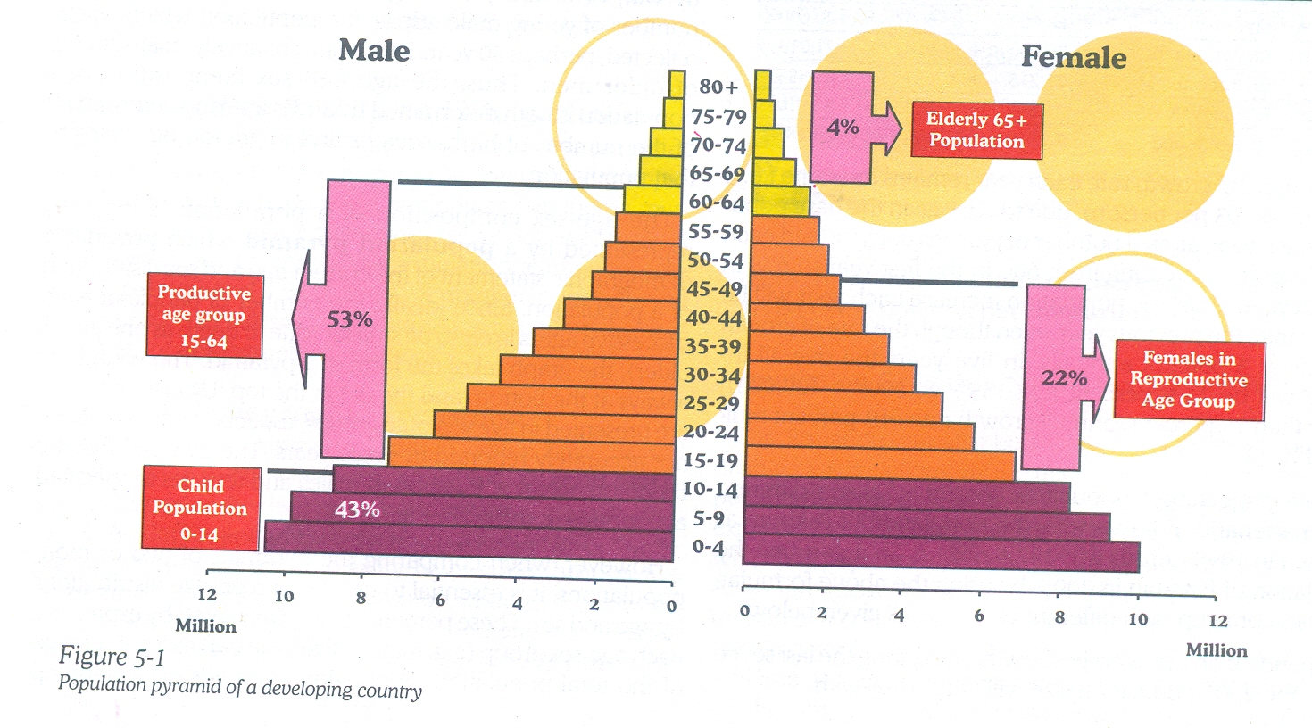

Slide 23
Profiles of Population Pyramid
Rapid Growth
Slow Growth
Zero / Negative Growth

Slide 24
THREE GENERAL PROFILES OF POPULATION PYRAMID
Population of countries can differ markedly as a result of past and current patterns of fertility, mortality, and migration. However, they all tend to fall into three general profiles of age-sex composition.
  Rapid growth is indicated by a pyramid with a large percentage of people in the younger ages.
  Slow growth is reflected by a pyramid with a smaller proportion of the population in the younger ages.
  Zero growth or decreasing populations are shown by roughly equal numbers of people in all age ranges, tapering off gradually at the older ages.

Slide 25
1. Rapid Growth
A large percentage of people in the younger ages.

Slide 26
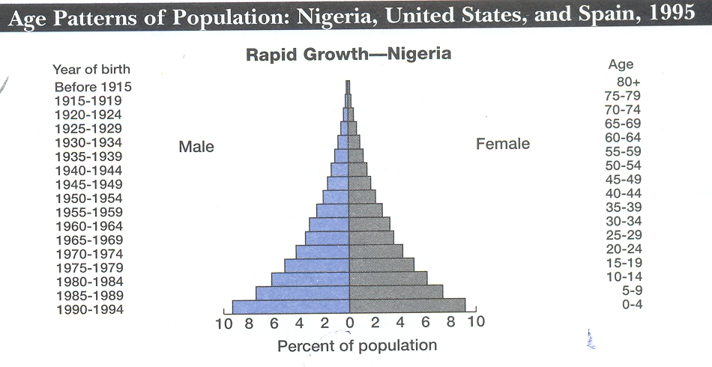

Slide 27
2. Slow Growth
A pyramid with a smaller proportion of the population in the younger ages

Slide 28
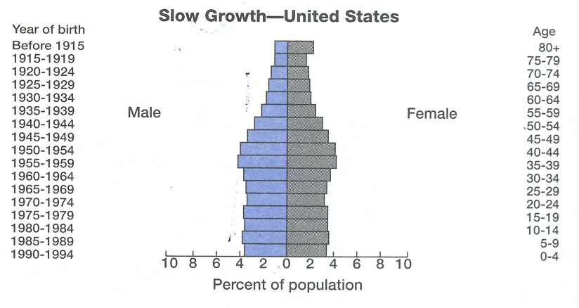

Slide 29
3. Zero or Declining Growth
Shown by roughly equal numbers of people in all age ranges, tapering off gradually at the older ages.

Slide 30
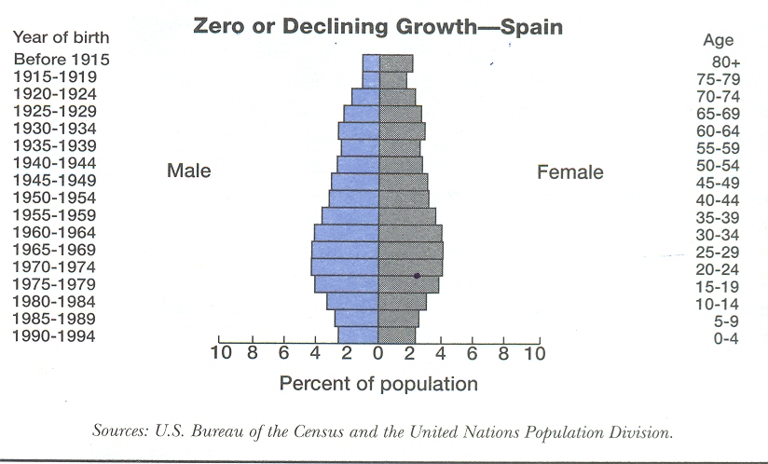

Slide 31
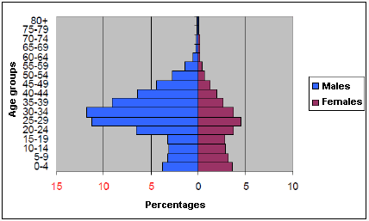
In migration

Slide 32
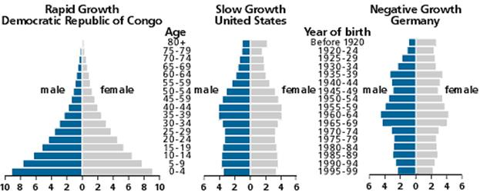

Slide 34
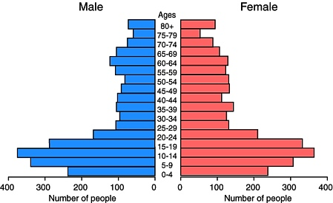
Out migration

Slide 36
Fertility

Slide 37
FERTILITY
Fertility refers to the number of live births women have.

Slide 38
Terms used in connection with fertility
FECUNDITY:
Which refers to the physiological capability of women to reproduce.

Slide 39
LIVE BIRTH:
The outcome of expulsion of conception form its mother and detachment of placenta after which the baby shows some signs of life such as movement of umbilical cord, pulse, breathing or movement of heart etc.

Slide 40
STILL BIRTH:
An outcome of expulsion of conception from its mother and detachment of placenta after which the baby dose not show any sign of life such as movement of umbilical cord or movement of heart etc.

Slide 41
PARITY:
Parity is the number of children born alive to a woman.

Slide 42
EFFECTIVE FERTILITY:
The term is sometimes used when late foetal deaths (including miscarriages, abortions and stillbirths), and in some cases the deaths of infants or children are excluded from consideration.

Slide 43
TOTAL FERTILITY
It refers to live births miscarriages abortions and still births.

Slide 44
PREMATURE DELIVERY:
Premature delivery or premature confinement or premature birth means an end of the pregnancy before the normal period but after six months premature babies normally weigh less than 5.5 pounds or 2.5 kilograms.

Slide 45
BIRTH AT TERM:
when the birth takes place not before six months of pregnancy and at around nine months.

Slide 46
REPRODUCTIVE PERIOD:
This period begins from the menarche or appearance of the first period or menses in women, and ends at menopause, that is the ceasing of menses.

Slide 47
STERILITY
Sterility means incapability of a woman to produce a child. A sterile couple can not produce a child. The sterility may be due to either or both partners

Slide 48
PRIMARY STERILITY:
A woman who has never been able to produce a child.

Slide 49
SECONDARY STERILITY:
Means a woman unable to produce a child after giving birth to at least one child. It could be permanent or temporary in nature.

Slide 50
TEMPORARY STERILITY:
A woman has a sterile period in each menstrual cycle because generally conception can occur only during a few days around the time of ovulation days and during puerperium period that is, the period of six weeks after delivery during which the uterus usually regains its normal size and in which the probability of conception is very low.

Slide 51
Fun time
Name different demographic tools
Name and draw three general profiles of a population pyramid?

Slide 52
Assignment
Draw Population pyramid of Pakistan alongwith percentages of either gender in different age groups
Date of submission
  Before CBL on 9th Jan 2013

Slide 53
Thank You

