Slide 1
Demography - 3
Maj Syed Fawad Mashhadi

Slide 2
The Demographic Transition
Change that populations undergo from high rates of births and deaths to low rates of births and deaths
High levels of births and deaths kept most populations from growing rapidly throughout most of time
In fact, many populations not only failed to grow but also completely died out when births rates did not compensate for high death rates
Death rates eventually fell as living conditions and nutrition improved

Slide 3
The Demographic Transition……
The decline in mortality usually precedes the decline in fertility, resulting in population growth during the transition period
Fertility rates fall neither as quickly nor as dramatically as death rates, and thus population grows rapidly

Slide 4
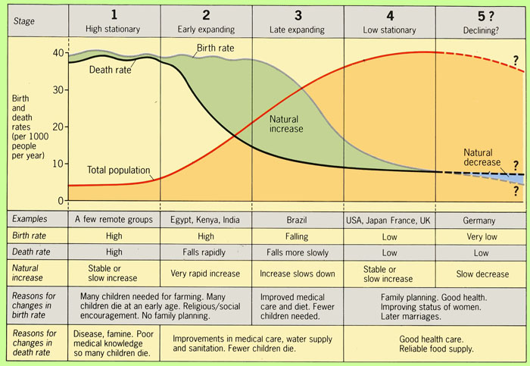

Slide 9
Demographic Transition & Corresponding Population Pyramids

Slide 10
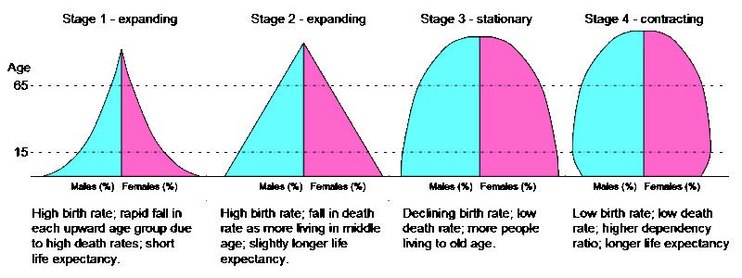

Slide 14
Finland is a good example of a country that has passed through the four stages of the demographic transition.
Stage I
High birth rate, high death rate= little or no growth
(Finland in 1785 -1790)
Birth rate: 38 per 1,000
Death rate; 32 per 1,000
Rate of natural increase: 0.6 percent

Slide 15
Stage II
High birth rate, falling death rate = high growth
(Finland in 1825 -1830)
Birth rate: 38 per 1,000
Death rate: 24 per 1,000
Rate of natural increase:1.4 percent

Slide 16
Stage III
Declining birth rate, relatively low death rate= slowed growth
(Finland in 1910 -1915)
Birth rate: 29 per 1,000
Death rate; 17 per 1,000
Rate of natural increase: 1.2 percent

Slide 17
Stage IV
Low birth rate, low death rate= Very low population growth
(Finland in 1996)
Birth rate: 12 per 1,000
Death rate: 10 per 1,000
Rate of natural increase:0.2 percent

Slide 18
Beyond Transition
Fifth stage
Number of people is actually decreasing
When fertility falls to very low levels and stays there for a protracted period, a slow rate of population growth can turn into a negative one.
Many countries in Europe now have TFRs below the replacement level of about two children per woman. In the late 1990s, the TFRs of Bulgaria, Italy, Spain, the Czech Republic, Latvia, and Russia all were 1.2 among the world’s lowest.

Slide 19
Communicable &
Non- Communicable Disease Comparison with
Stages of Demographic Transition

Slide 20
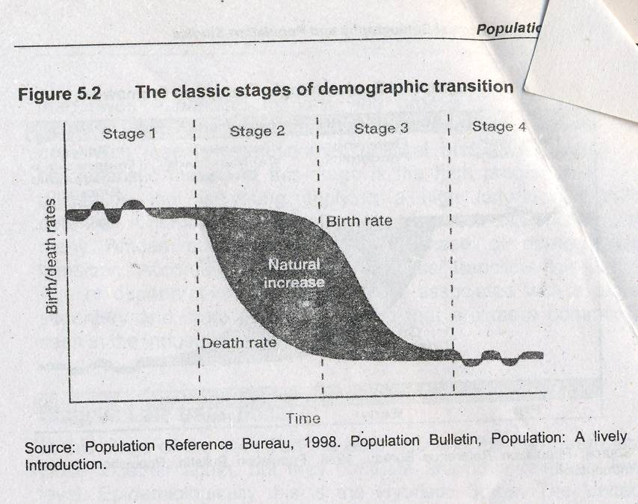
Non-Communicable
Diseases
Communicable
Disease

Slide 21
Replacement level Fertility
When a couple has 2 births during the reproductive life
  Just enough to replace themselves.
At a community scale the replacement level is achieved when
  TFR
    2.1
  NRR
    1

Slide 22
Population Momentum
Tendency of a population to continue to grow after replacement-level fertility has been achieved.
Total births continue to exceed total deaths as these youth become parents.
This large group becomes elderly and deaths increase to equal or outnumber births.
Thus it may take two or three generations (50-70 years) before each new birth is offset by a death in the population .

Slide 23
Improved quality of Health care Declining DR but BR is still high
High Population Growth
Falling living standards
High fertility
Decline in living standards
More poverty
People rely on more children to provide them with economic security
Explosive population
Demographic Trap - Stage 2 (Inc BR, Declining DR)

Slide 24
Demographic Trap – Example
Sudan (Failed State ?----- Classic Case)
  It has developed far enough economically and socially to reduce mortality,
  but not far enough to quickly reduce fertility
  As a result, women on average have four children, double the two needed for replacement, and the population of 41 million is growing by over 2,000 per day
  Under this pressure, Sudan—like scores of other countries—is breaking down.

Slide 25
Epidemiologic Transition
Pestilence (infections) & Famines
  Infections & Nutritional Deficiencies
Receding Pandemics
  Improved sanitation, Dec infections, Inc Diet (salt), inc Aging
  Developing Countries
Degenerative & Man made Diseases
  Inc aging, Lifestyles related to high SES, (diet, activity, addiction)
  Countries in transition
Delayed degenerative & emerging infections
  (Hybristics)
  Reduced risk behaviors (Health promotion and prevention)
  New treatments
  Western countries

Slide 26
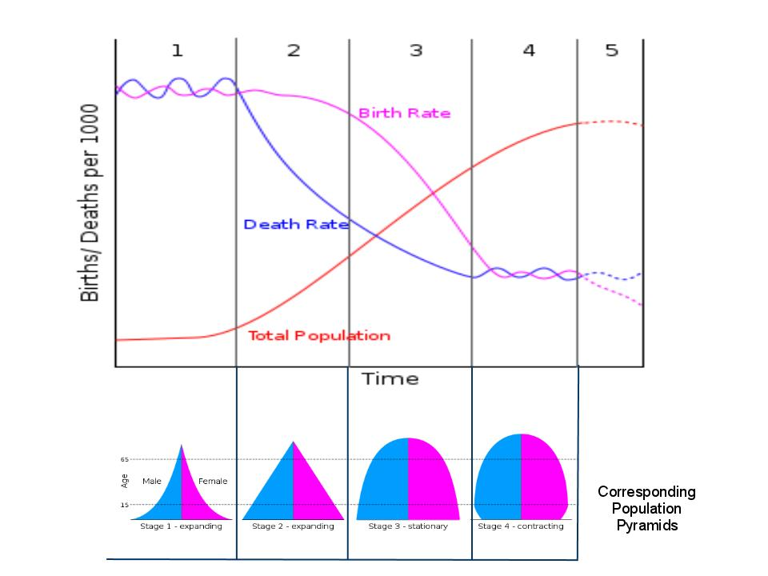
Pestilence & Famines
Receding Pandemics
Degenerative & Man Made diseases
Delayed Degenerative & Emerging Infections
High Stationary
Early Expanding
Late Expanding
Low Stationary
Declining

Slide 27
Urbanization & Distribution

Slide 28
Urbanization and Distribution
Urbanization is the increase population living in urban areas the process of people moving to cities or other densely settled areas.

Slide 29
Urban
Countries differ in their definitions of urban, although it is fairly common for the urban population to consist of those living in towns and cities of 2,000 or more, especially if the population is largely nonagricultural. In densely populated Japan, the term “Urban” refers to areas with populations of 5,000 or more and with a population density of 1,544 or more per square Kilometer. In the United States, places with populations of 2,500 or more are considered urban.

Slide 30
Population density
Population density is usually expressed as the number of people per unit of land area.
Total population = 20,140,000 = 61.1 Total lands area 329,750
In 1995, Malaysia had a population density of 61 persons per square kilometer of land area. -----------

Slide 31
PERCENT URBAN
The population living in urban areas can be expressed as a percentage of the area’s total population and is a measure of urbanization. Usually the remainder of the population is considered rural, although some countries also have a middle category designated “semi urban.”

Slide 32
Push and pull factors
Migration can occur as result of push and / or pull factors.
Push factors
  Force at person to migrate out of the area
Pull factors
  Which encourage a person to migrate in that area

Slide 33
Push Factors
VALID UNDER NORMAL CONDITIONS
Head of the family moves
Transfer of job
Marriage
Business and economic deprivations
Absence of or poor educational facilities
Retirement and no re-employment
No housing shelter
Divorce
Fragmentation of agriculture land
Poor relationship with other members of the original community

Slide 34
Valid under abnormal conditions
War and fear or threat of war
Civil war and insecurity
Racial discrimination
Oppression
Cultural
Over crowding etc

Slide 35
Natural calamities
Earthquakes
Excessive rainfall and floods
Long persistent drought
Weather severity
Eruption of volcano
Severe and repeated cyclones
Epidemics etc

Slide 36
The pull factors are:
Employment
Economic benefits
Better educational facilities
Availability of better health facilities and medical treatment
Returning home
Peace and no fear on threat of war
Security
Racial harmony
Greater freedom

Slide 37
Better standard of living
No oppression
No culture
No earthquakes
Better climates
Hygiene
Fertile land

Slide 38
Effects of Urbanization
SHORTAGE OF:
Educational facilities | Living space
Health service | Arable land
Housing units | Clean water
Food
INCREASE IN:
Unemployment | Over crowding
Land fragmentation | Katchi abadies
Import of foods etc. | Poverty
Environmental problems | Unrest
Congestion in households | crime

Slide 39
Census

Slide 40
CENSUS
Process of collecting, compiling and publishing demographic, economic and social data pertaining to a specific time from all persons in a country.

Slide 41
METHODS
Enumerations
      Pre-enumeration
      Enumeration
      Post-enumeration
Questionnaire
Combination of both

Slide 42
Types of Census
DE- FACTO:
A person is at the place he or she is found at the time of counting
DE- JURE:
A person is counted at the place of his or her actual residence

Slide 43
Information from Census
Population size
Urban-rural distribution
Marital status
Literacy/ educational attainment
Economic status
Occupation
Child population
Migration
Disability

Slide 44
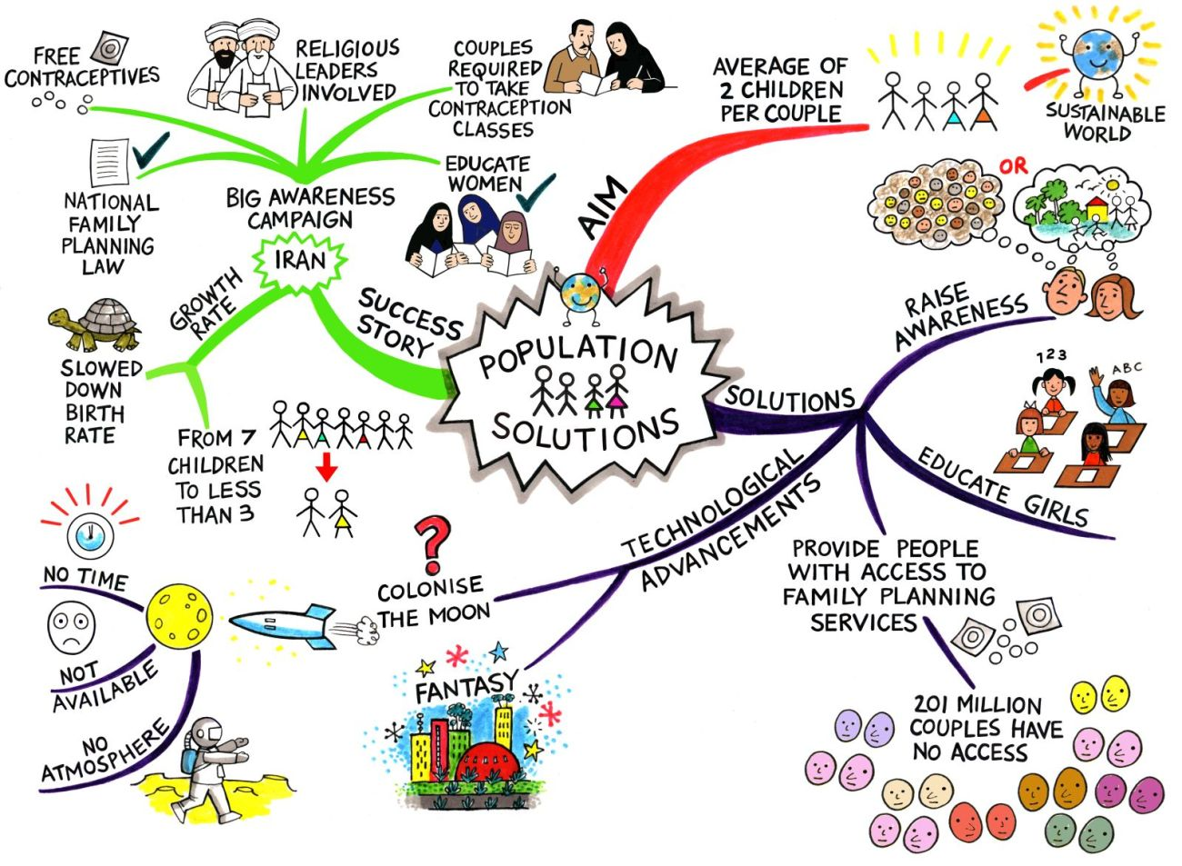
b. Crude birth rate

Slide 45
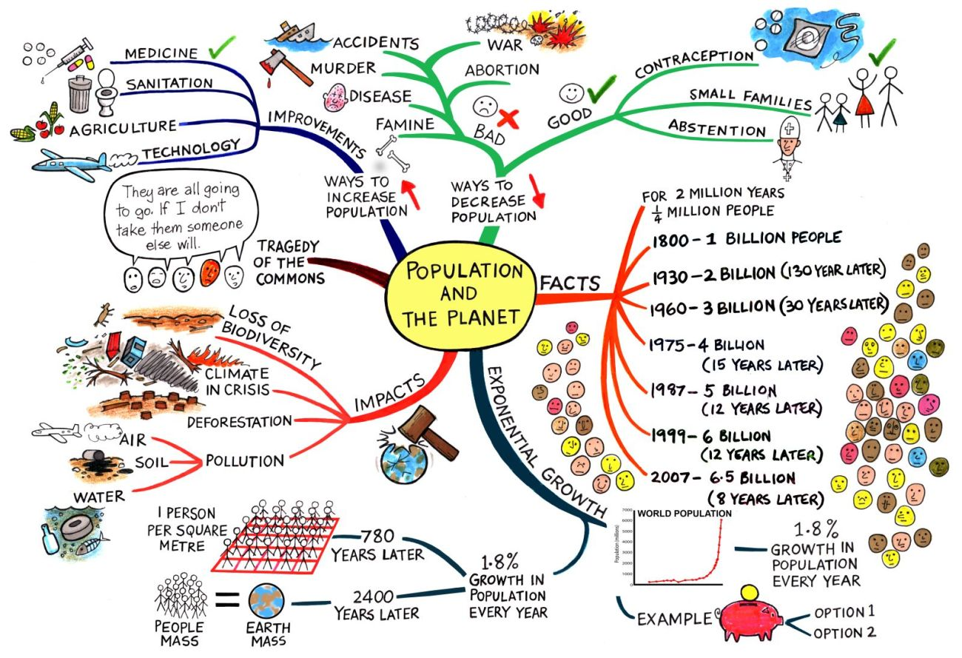

Slide 46
Entertainment
What are the stages of Demographic transition?
What is meant by demographic trap?
What is census? Enumerate its types.

