Slide 1
HEALTH EDUCATION

Slide 2
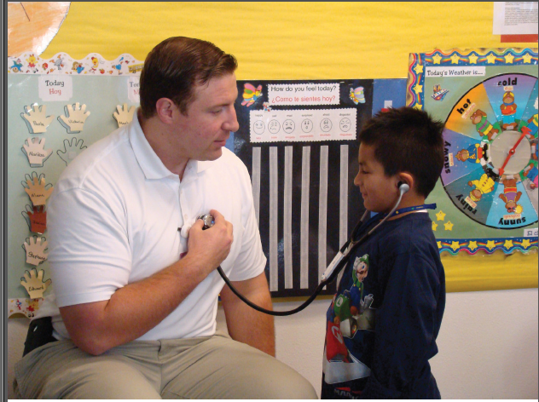

Slide 3
Definition
“Health education is the process by which individuals and group of people learn to “:
Promote
Maintain
Restore health.
“Education for health begins with people as they are, with whatever interests they may have in improving their living conditions”.

Slide 4
Health Education
Definition - WHO
Process of providing information and advice related to healthy lifestyle and encouraging the development of knowledge, attitudes and skills aimed at behaviour change of individuals or communities.
Enables and influences controll over own´s health leading to optimalization of attitudes and habits related to lifestyle and increasing quality of life.

Slide 5
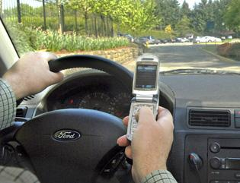
Health Education/Health Promotion
‘Texting While Driving’
What message is being put across?
Where have you seen it before today?
Who is it aimed at?
Do you think it will change peoples’ behaviour? Why?/Why not?

Slide 6
What is Health Education?
Educating people to have healthier lifestyles so they can AVOID disease
Health Education aims to:
- inform people through knowledge
- change unhealthy attitudes
- change unhealthy behaviours
Its REALLY difficult to get people to change their attitudes and behaviour!

Slide 7
Historical Development
When did health education become a concern?
Research:
- WHO’s Health for All By the Year 2000
- Alma-Ata Declaration 1978
- Ottawa Charter for Health Promotion 1986
- The Black Report 1980
- Inequalities in Health: The Black Report & the Health Divide (1987)

Slide 8
Health education or Health Promotion?
“Any combination of learning experiences designed to facilitate voluntary adaptation of behavior conducive to health”.
- All possible channels of influence on health are appropriately combined and designed to support adaptation of behavior.
- The word “voluntary” is significant for ethical reasons.

Slide 9
Educators should not force people to do what they don’t want to do.
i.e. All efforts should be done to help people make decisions and have their own choices.
- The word “designed” refers to planned, integral, intended activities rather than casual, incident, trivial experiences.

Slide 10
Health education or Health Promotion?
With rising criticism that traditional H.E. was too narrow, focused on individual’s lifestyle and could become “victim blaming”, more work was done about wider issues e.g., social policy, environmental safety measures
(Emergence of Health Promotion)

Slide 11
Health Promotion:
A widely used term to encompass various activities e.g. :
  Behavior & lifestyle,
  Preventive health services,
  Health protection directed at environment,
  Health related public policy,
  Economic & regulatory measures.
(Health Education is the primary and dominant measure in Health Promotion )

Slide 12
Aims of Health Education
1. To develop a sense of responsibility for health conditions, as individuals, as members of families & communities.
(Promotion, prevention of disease & early diagnosis and management ).
2. To promote and wisely use the available health services.
3. To be part of all education, and to continue throughout whole span of life.

Slide 13
Process of Health Education
Dissemination of scientific knowledge
(about how to promote and maintain health),
leads to changes in KAP related to such changes.

Slide 14
Steps for Adopting New Ideas & Practices
Awareness (Know about new ideas)
Interest (Seeks more details )
Evaluation
(Advantages versus disadvantages + testing usefulness )
Trial (Decision put into practice)
Adoption
(person feels new idea is good and adopts it)

Slide 15
Contents of Health Education
Nutrition
Health habits
Personal hygiene
Safety rules
Basic (K) of disease & preventive measures
Mental health
Proper use of health services
Sex education
Special education for groups( food handlers, occupations, mothers, school health etc. )
Principles of healthy life style e.g. sleep, exercise

Slide 16

Principles of Health Education
Interest
Participation
Motivation
Comprehension
Proceeding from the known to the unknown
Reinforcement through repetition
Good human relations
People, facts and media:
“knowledgeable, attractive , acceptable “.

Slide 17

Principles of Health Education
Learning by doing:
“ If I hear, I forget
If I see, I remember
If I do, I know”.
Motivation,
i.e. awakening the desire to know and learn:
- Primary motives, e.g. inborn desires , hunger, sex.
- Secondary motives,
i.e. desires created by incentives such as praise, love, recognition, competition.

Slide 18
Communication in Health Education
Education is primarily a matter of communication, the components of which are:
CHANNELS AUDIENCE MESSAGE COMMUNICATOR
- Individual - Conform with - Educator
- Media - Group objectives.
-----------------------------------------------------------------------------------------
- 2 way - Public - understandable - needs+ interest of audience
-----------------------------------------------------------------------------------------
- 1 way - Public - Acceptable - ? Content of
message
-----------------------------------------------------------------------------------------

Slide 19

Evaluation of Health Education Programs
There should be continuous evaluation.
Evaluation should not be left to the end but should be done from time to time for purpose of making modifications to achieve better results.

Slide 20
EVALUATION CYCLE:
Describe problem Describe program State goals Determine needed
information
Modify program Establish basis for
proof of effectiveness
Analyze &compare Organize data Develop& test Determine data
results base instruments collecting method

