Slide 1
Learning Outcomes
To understand Principles of Health Education
To discuss the role of Communication in HE
To apprehend the Practices of HE
To study Models of HE

Slide 2

Principles
Interest (unlikely to listen to uninterested) Felt Needs
Credibility (based on facts)
Participation (active learning ) Practical experience
Proceeding from the known to the unknown (Knowledge)
Comprehension (mental capacity)
Reinforcement through (repetition)
Good human relations (friend confidence)
People, facts and media:
“knowledgeable, attractive , acceptable “.

Slide 3

Principles -2
Learning by doing (leaves a lasting imprint)
“ If I hear, I forget
If I see, I remember
If I do, I know”.
Motivation (create and awaken the desire
to know and learn)
- Primary motives (inborn desires, hunger, sex)
- Secondary motives (created by incentives such as praise, love, reward recognition, competition)
Leadership: People learn best from respected & admired

Slide 4
Role of Communication in Health Education

Slide 5
The Purpose
To transmit information from one person or group of persons to other persons or groups with a view to bring about behavioural changes.
Key Elements in Communication process
  The communicator
  The message
  Audience
  Channels of Communication

Slide 6
A Communication Process Model
Feedback
Transmission
of
Message
Thought
Encoding
Reception
Decoding
Understanding
Sender
Receiver
Noise

Slide 7
Communicator
He/she is the originator of the message
Attributes of communicator
  A communicator must know
  His/her Objectives-- clearly defined
  His/her audience-- its needs, interests and abilities
  His/her message-- its content, validity and usefulness
  Channels of communication

Slide 8
Message
The information a communicator wishes his audience to receive, understand, accept and act upon.
Attributes of a good message
  In line with the objectives
  Carefully chosen
  Clear and understandable
  Specific
  Timely
  Appealing

Slide 10
Audience
They are the consumers of the message. The audience may be the total population or a group of population.
School Children
Women visiting Hosp for Antenatal Check-up
Workers in a factory
High Risk Group (IV drug users)
Patients

Slide 12
Channel of Communication
The medium of communication
The choice of medium is an important factor in the effectiveness of communication
It should be carefully selected bearing in mind its ability to deliver the message, its cost and availability
Provide variety of channels
Communication should be adjusted to local cultural patterns

Slide 13
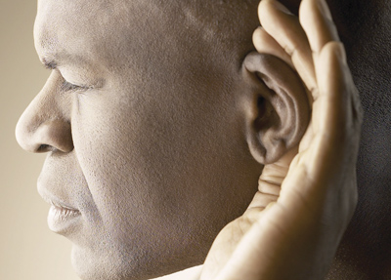
Barriers of Communication
Planning Bad
  Lack of planning, unclear assumptions
Physiological
  Difficulties in hearing, poor expression, distortion
Psychological
  Emotional disturbance, neurosis, distrust, threat & fear
Environmental
  Noise, invisibility, congestion, Info overload
Cultural
  Levels of knowledge and understanding, customs, beliefs, religion and attitudes

Slide 14
Practice of Health Education-1
Three main levels
  Individual
  Group
  General Public
Individual and Family Health Education
  Personal Interviews
  Advantage: We can discuss, argue and persuade the individual to change the behavior.
  Limitation: The numbers we reach, are small and health education is given to only those who come in contact with us.

Slide 15

Practice of Health Education-2
Group Health Education
  An effective way of teaching the community
  It must relate directly to the interest of group.
Methods of Group Health Education
  Lectures
  Group Discussions
  Panel Discussion
    4 to 8 qualified persons discuss a given problem in front of a large group of audience.
  Symposium
    Series of speeches on selected subject.
    Each person/ expert present an aspect of the subject briefly.

Slide 16

Practice of Health Education-3
Workshop
  Consists of series of meetings, usually four or more, with emphasis on individual work within the group with the help of consultants and resource personnel
  Learning takes place in a friendly and democratic atmosphere under expert guidance
Role Playing
  Situation is dramatized by the group
  Role playing is followed by the discussion of the problem

Slide 17
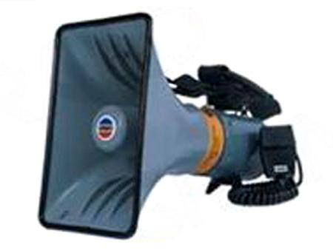
Practice of Health Education-4
Education of General Public
  Mass Media of Communication is employed
    Television, Radio, Press
    Films, Health Magazines
    Posters
      Attract attention
      Message should be short, simple, direct and easy to understand
      The right amount of matter should be put up in right place at right time
      Posters should be changed frequently
    Health Exhibitions, Health Museum

Slide 18
Model-1 of Behaviour Change
Health Consciousness
Knowledge
Self-Awareness
Attitude change
Decision Making
Behavioral Change
Social Change

Slide 19
Steps for adopting new ideas & practices
Awareness (Know about new ideas)
Interest (Seeks more details )
Evaluation (Advantages versus disadvantages+ testing usefulness )
Trial (Decision put into practice)
Adoption (person feels new idea is good and adopts it)

Slide 20
2- AIETA Model
Awareness
Interest
Evaluation
Trial
Adoption

Slide 21
RUI Model of Interpersonal Communication
1. R: Rapport
2. U: Understanding
3. I: Influence
Rapport
Establish sympathetic relationship
Person feels accepted and welcomed.
His/her fears are removed.
Better exchange of information.

Slide 22
1. How to Establish Good Rapport
Greeting the person with warmth and acceptance
Proper introduction of self and the person
Giving full attention
Using simple, straightforward and familiar language
Showing respect
Being pleasant
Showing concern and interest
Sending positive non-verbal messages
Avoid judgmental responses

Slide 23
2. Understanding By Health Educator
Try to get better understanding of the situation/problem by obtaining accurate information from the person.
Listen with concentration.
Avoid unnecessary interruptions.
Observe the person and surroundings carefully.
Encourage e.g. offer praise for healthy behavior
Give importance to what the person has to say

Slide 24
3. Influence
Influence the person to take desired action by:
Giving up to date information and guidelines.
Providing key information and explaining what needs to be done.
Using visual aids to explain.
Using demonstrations to teach new skills.
Using easily understandable language.
Explaining the benefits of the behavior you are trying to promote.
Focusing on things that are essential and useful to know avoiding unnecessary details.

Slide 25
If you are thinking ahead sow a seed.
If you are thinking ten years ahead, plant a tree.
If you thinking one hundred years ahead, educate the people.

Slide 26


